Slide 1
480 L/s Plant
Hydro Homies
Notes:
Ian

Slide 2

Design Motivations
Partners requesting higher flow plants
Requests from 120-480 L/s
Start planning how to scale
Notes:
Ian

Slide 3

Primary Design Considerations
Cost/Space
Operator Ease of Use
Daily Use
Maintenance
Use of existing Designs from AguaClara
Number of treatment paths
Manifolds
Space Efficient
Notes:
Katie

Slide 4
Unit Processes
Entrance Tank from TheFlocs
Assume 480 L/s
CDC from Phoenix Flocs
Assume 480 L/s
6 L/s Sed tanks in 60 L/s sedimentors
20 L/s filters
Notes:
Val

Slide 5
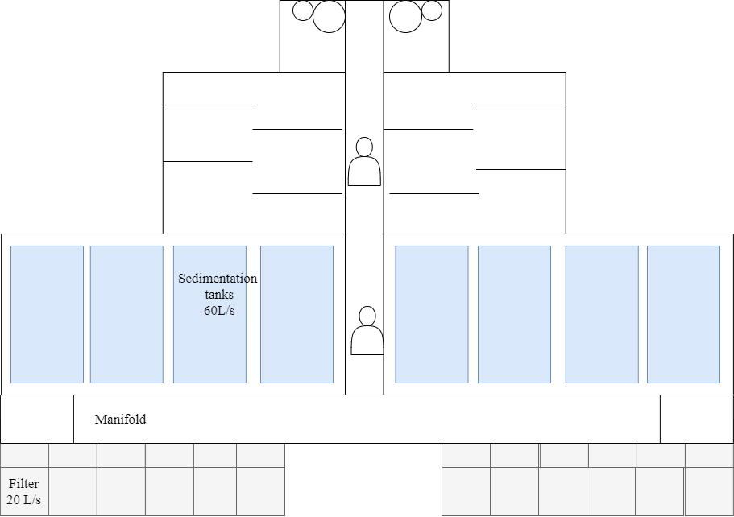
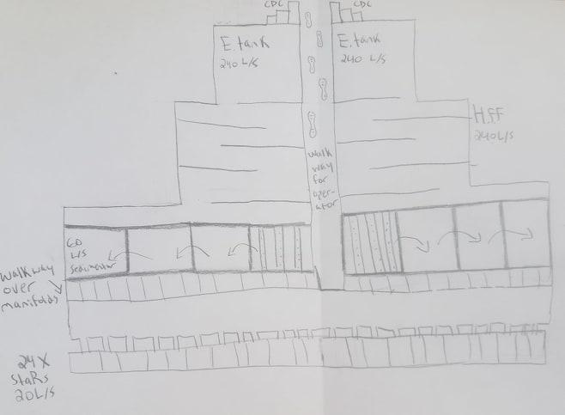
DEsign 1
Pros
Fully separate flow trains allow half to be taken off for testing
Design allows experimentation with differing chemical dosages
Processes can be taken offline easily for maintenance without disrupting flow
240 L/s
240 L/s
Cons
Larger plan view areas and thus higher costs
Lots of wasted space as sed tanks are wider than flocculator

Slide 6
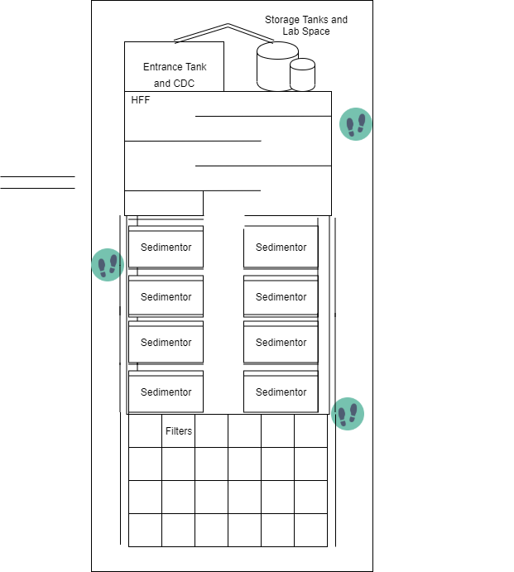
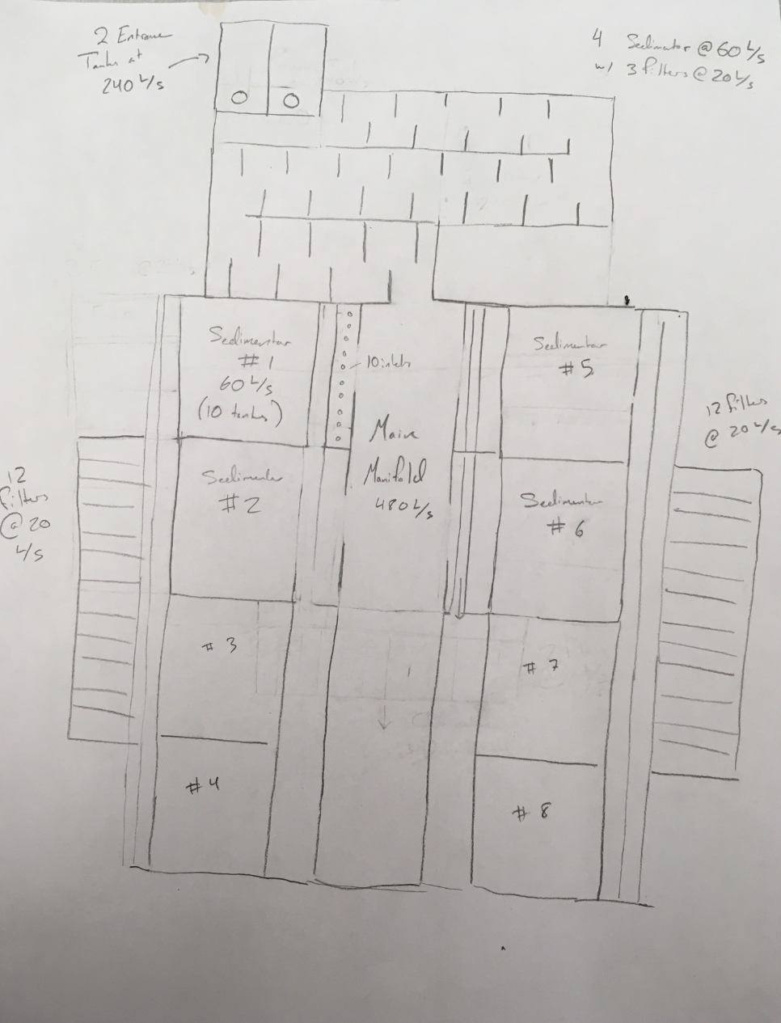
DEsign 2
Pros
Single path reduces space and material costs
Design provides many points of access for testing
Cons
Maintenance is more difficult with single flow path
Single inlet manifold needs careful design for good flow distribution and to prevent floc breakup

Slide 7
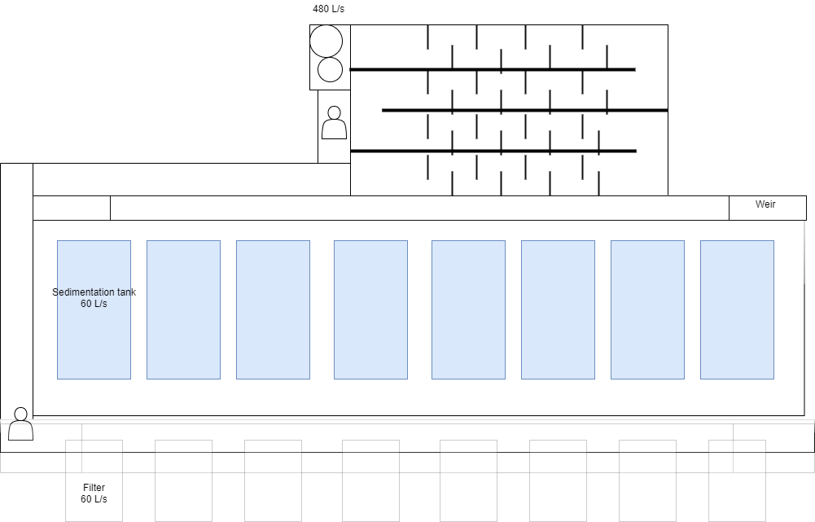
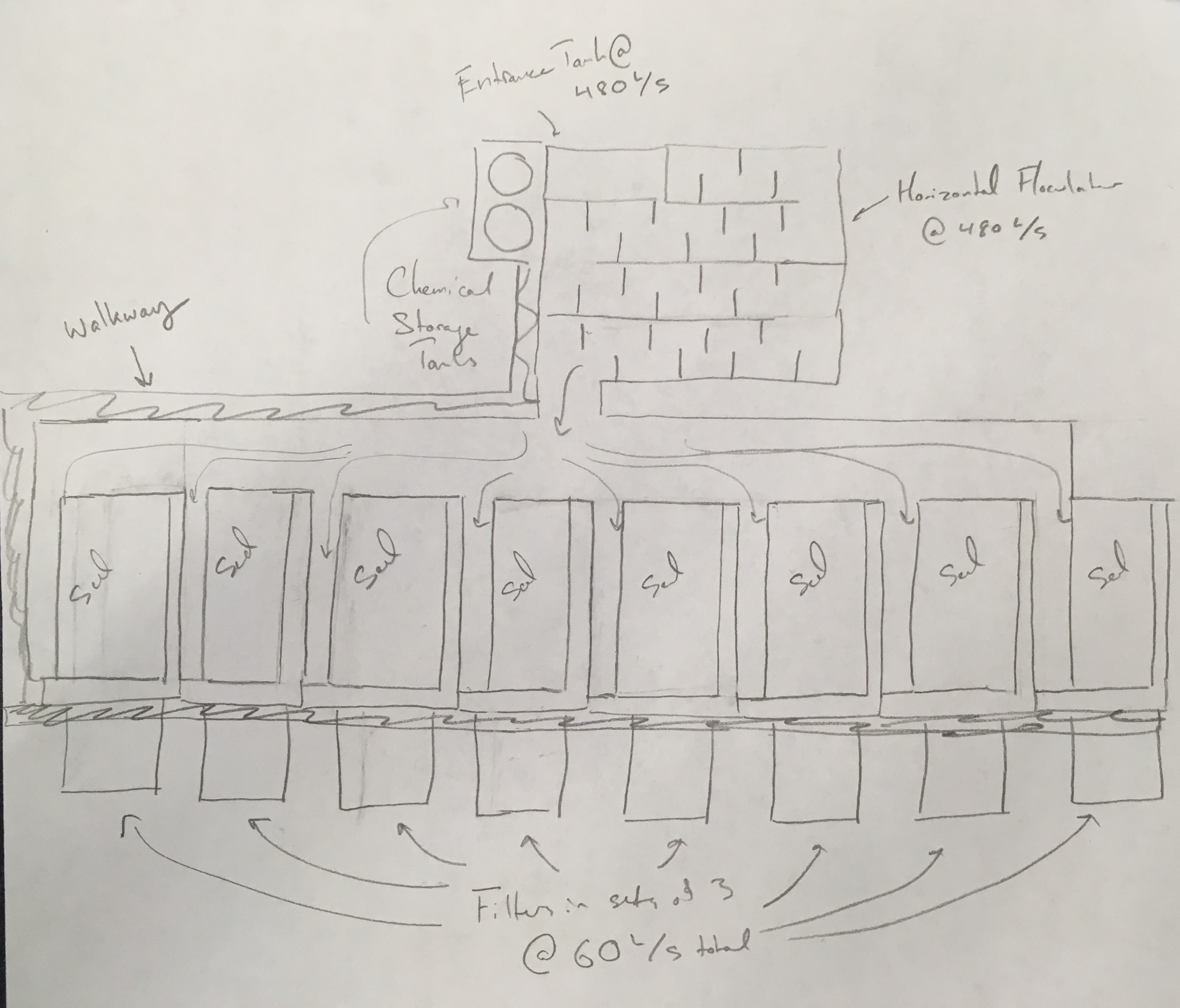
DEsign 3
Pros:
Offers high flexibility in flow distribution, each sed tank filter system can easily be taken offline
Ease of waste management with all sed tanks draining to one exit
Cons:
Worst use of space, lots of dead space on sides of flocculator
Same cons with one flow path as before
Notes:
Val

Slide 8
Final Decision
1 Treatment Path
Plentiful Walkways
Can individually take sed tank, filter offline (need most maintenance)
Efficient space usage
Notes:
Katie

Slide 9
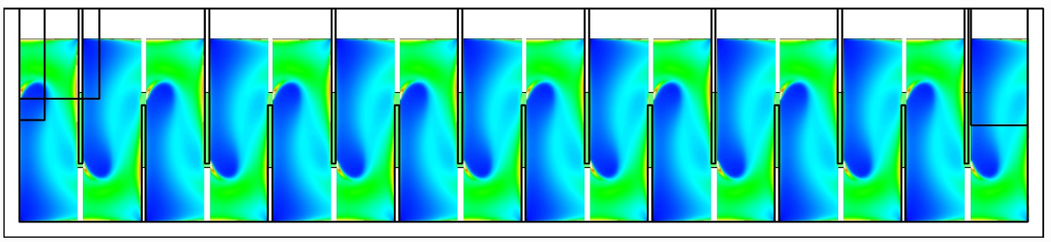
Horizontal Flow Flocculator
Min Q for Horizontal is ~220 L/s
Vertical Flow Flocculator
Side View
Depth H
Horizontal Flow Flocculator
One Channel Top View
Channel Width W
Notes:
https://aguaclara.github.io/Textbook/Flocculation/Floc_Design.html
Top-down design method
•Vertical flow flocculators are somewhat difficult to drain and clean
•For large flows, vertical flow flocculators have channels that are wider than they are deep

Slide 10
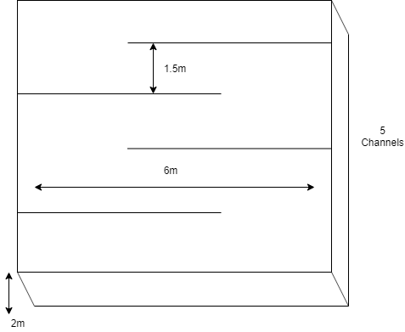
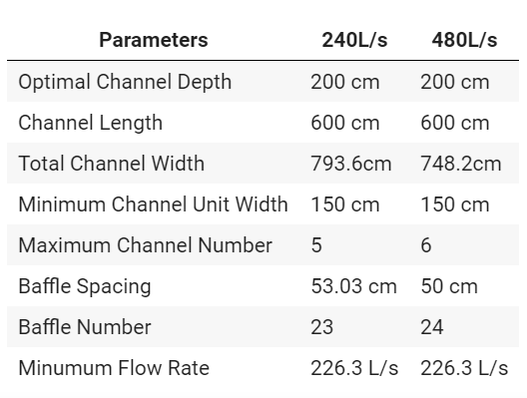
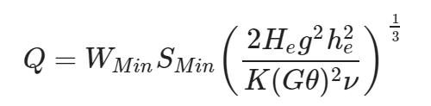
Switching H and W and using same procedures as Vertical Flow Flocculator
Height set the same as sedimentation tanks
H/S=3, H→ W
Around minimum baffle spacing
Notes:
AguaClara plants have been designed using H/s=3
Constraint ensures that the flow does not short-circuit through the flocculator and also allowing more space for the flow to expand after each contraction for the maximum flocculator efficiency concern.

Slide 11
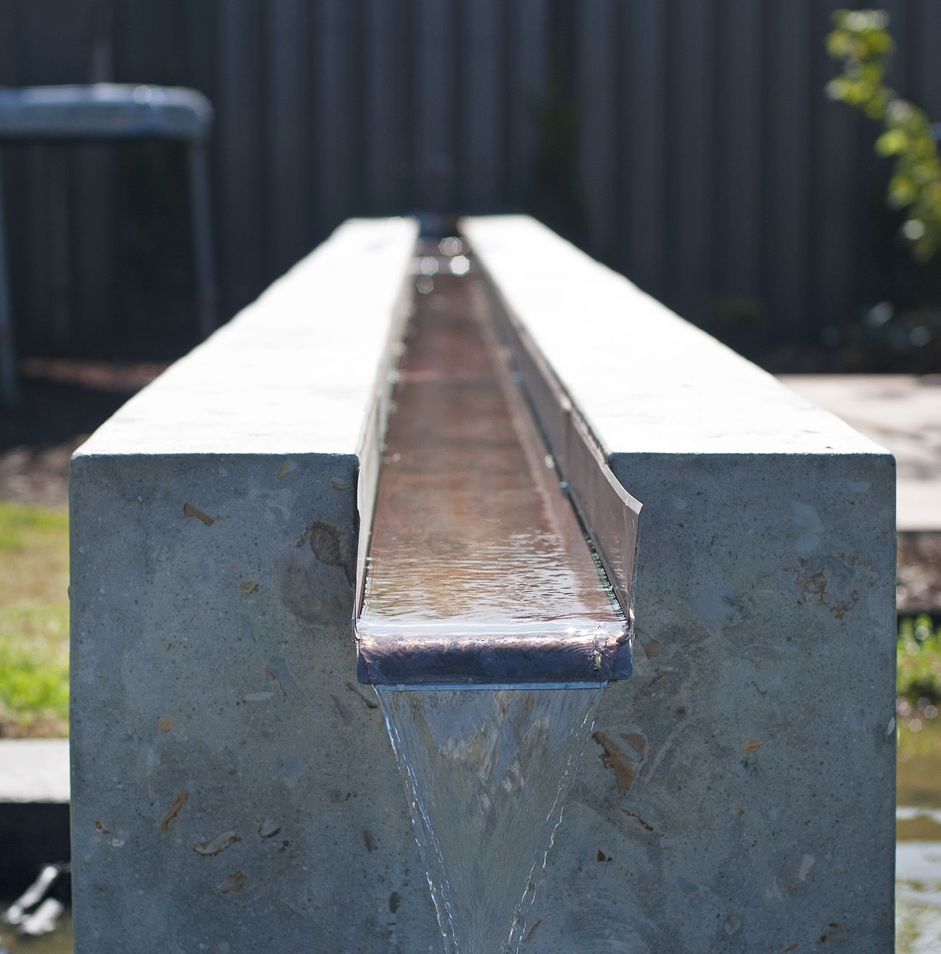
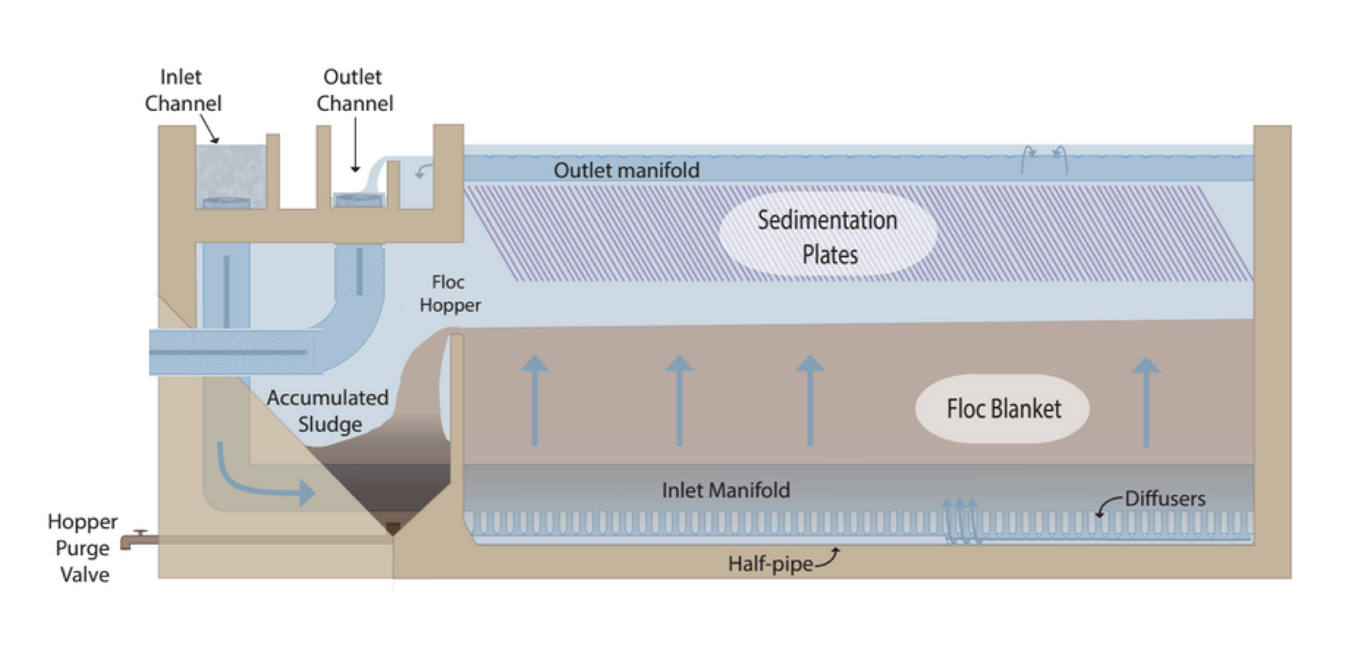
Manifold Design
Notes:
http://cuaguaclara.blogspot.com/2012/08/the-floc-blanket-quest.html
https://www.pinterest.at/pin/586101338986832494/

Slide 12
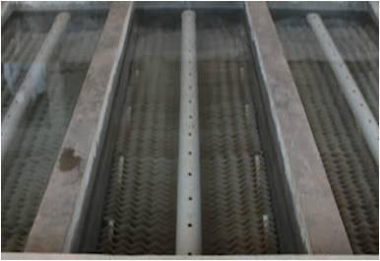
Key Discoveries
Headloss, and flow distribution set by effluent manifold

Slide 13
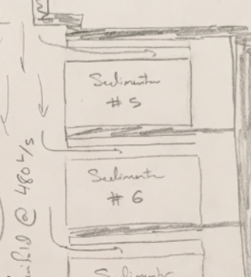
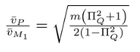
Key Discoveries
Manifold distribution must account for 2 sets of channels in series

Slide 14
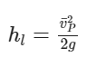
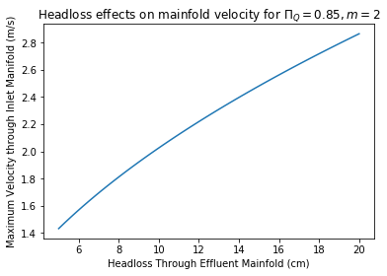
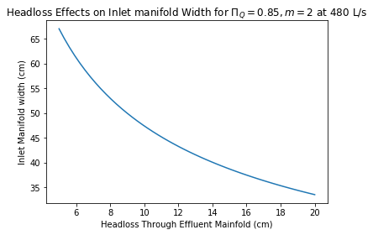
Key Discoveries
Increasing headloss allows for higher manifold velocity with stable flow distribution

Slide 15
Conclusions and Reflections
One treatment path is economical, feasible as we scale
Pivoting to horizontal flow flocculators will be crucial
More time should be invested in scaling up unit processes (sed tanks, filters)
Notes:
Ian

Slide 16
Thank you!
Notes:
Ian

